Slide 1
British Airways
Customer Insights & Marketing Informatics report

Slide 2
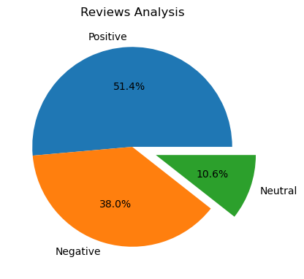
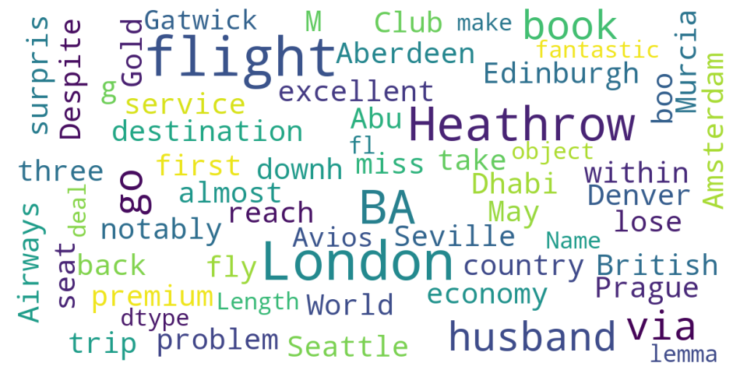
Sentiment Analysis & Key word analysis
Wordcloud Analysis
The majority of comments are about flights, Heathrow, and London. These locations and the actual flight experience need effort and more research.
Prague, Denver, Amsterdam, Seattle, Aberdeen, and Seville are the locations most frequently mentioned. These are the pathways that influence the majority of the reviews, thus it is critical that we concentrate our efforts on steadily improving them. The reviews appear to mention premium and economy equally, which shows that our efforts are balanced because we are able to draw in an equal amount of premium and economic clients. Depending on the path of the business, we might need to continue as we are or concentrate on pushing more of one of the business lines between premium and economy.
In a sample of 1,000 online evaluations for British Airways, 51.4% were favourable, 38% were unfavourable, and 10.6% were indifferent. Using the data above, we were able to calculate a net promoter score that distinguished between the good and bad experiences at 13.4%.This would result in a poor net promoter score, thus it's critical that we figure out how to turn the 10.6% neutrals into promoters. Budget-wise, converting neutrals is less expensive than converting negatives.

